Slide 1
Multivariate Analysis on US Open 2013
By Aniket Kumar
Anusha Papineni
Shafia Askari

Slide 2

Do you want to know about Tennis Players?

Slide 3
Data sets
Tennis Major Tournament Match Statistics DataSet
Source : UCI Machine Learning Repository
Women Tennis Players
Men Tennis Players
Variables: (FSP) First Serve Percentage, (FSW) First serve Win, (SSP) Second Serve Percentage, (SSW) Second serve, ACE, (DBF) Double Fault, (DBC) Double point created, (DBW) Double point Wins

Slide 4
What we wanted to do?
Compare men and women tennis performance
Find key characteristics
Compare match statistics of different players
Find Latent Vairiables

Slide 5
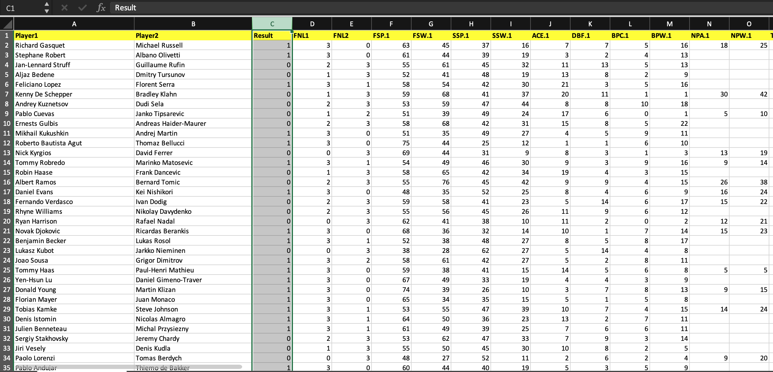
Original Data set
Two distinct datasets of men and women

Slide 6
Data cleaning:
Common Variables
Combine Rows
Aggregate Rows
Renaming the Columns

Slide 7
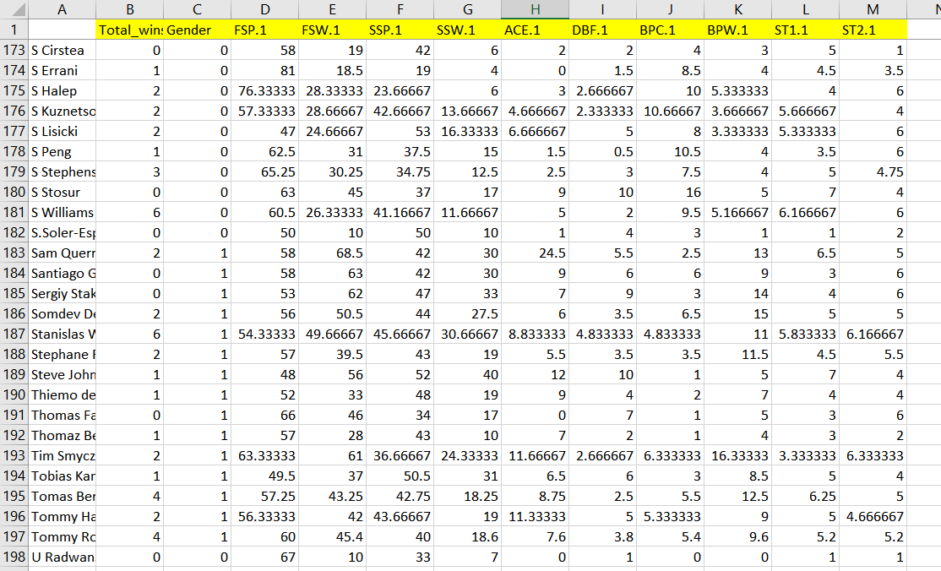
Data set after cleaning

Slide 8
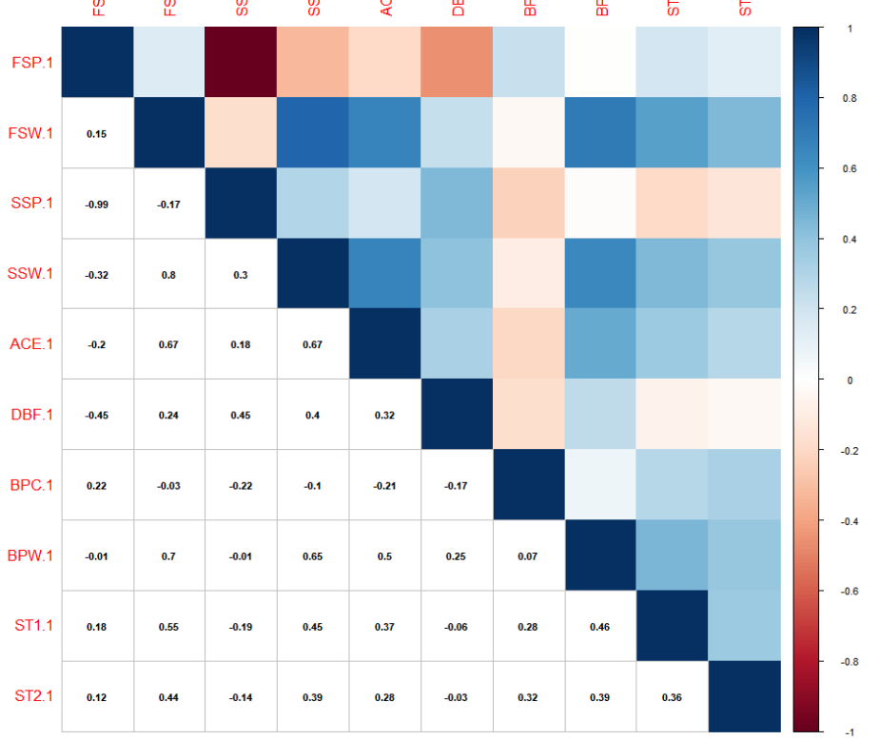
Correlation
SSP and FSP highly negatively correlated
ACE and First serve win and Second serve win are positively correlated
Break point win and Second serve win are positively correlated

Slide 9
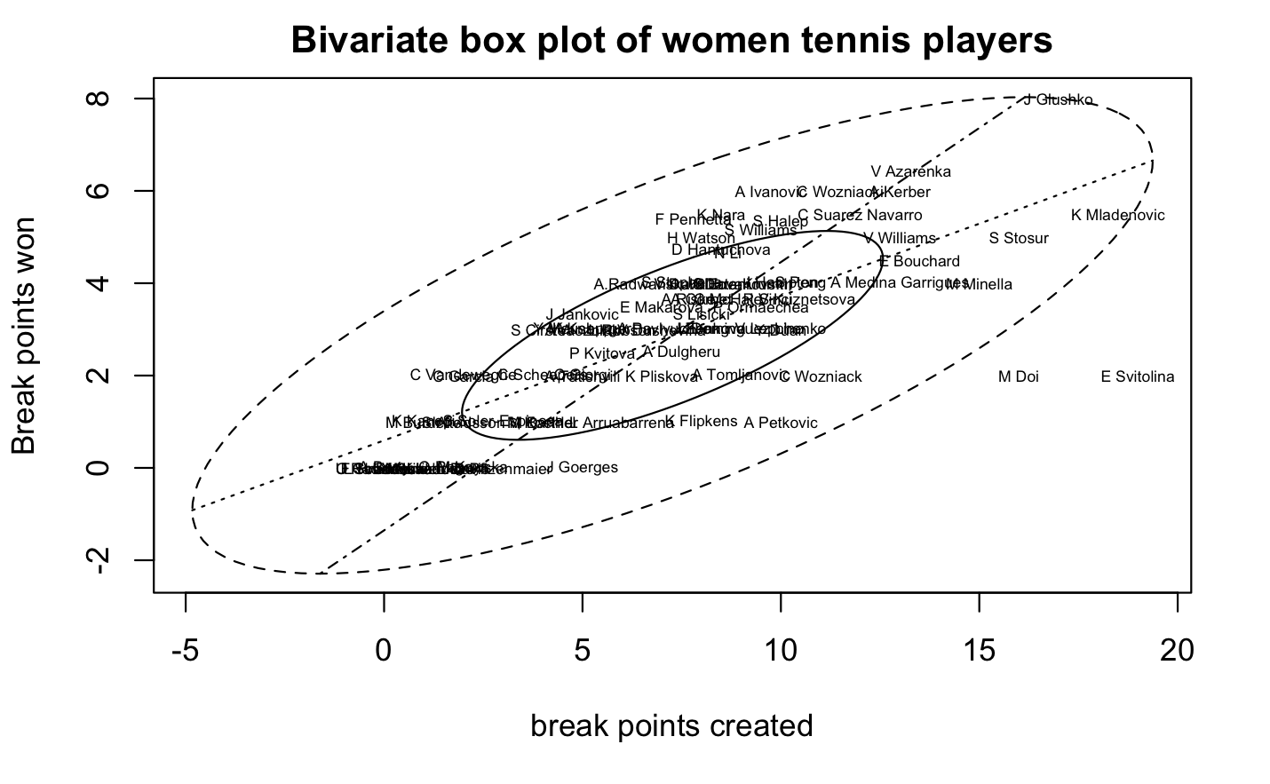

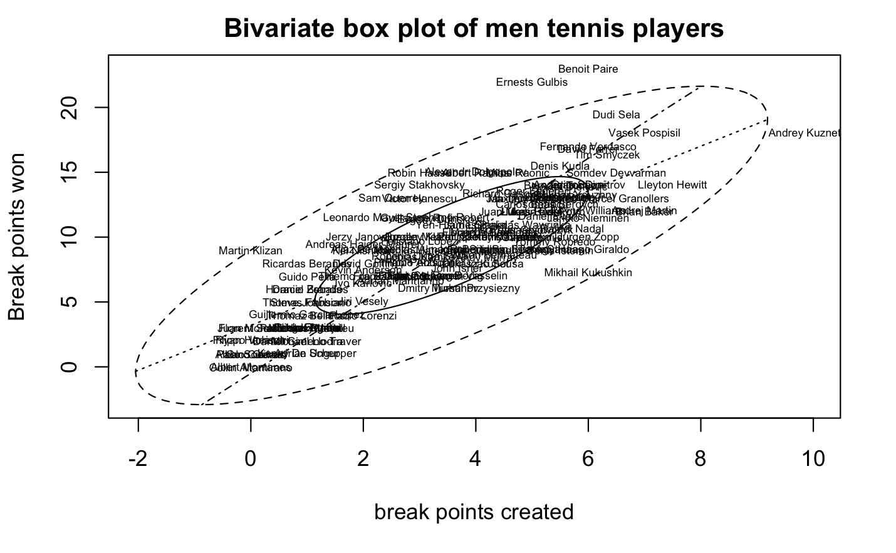
Bivariate Box PLot

Slide 10
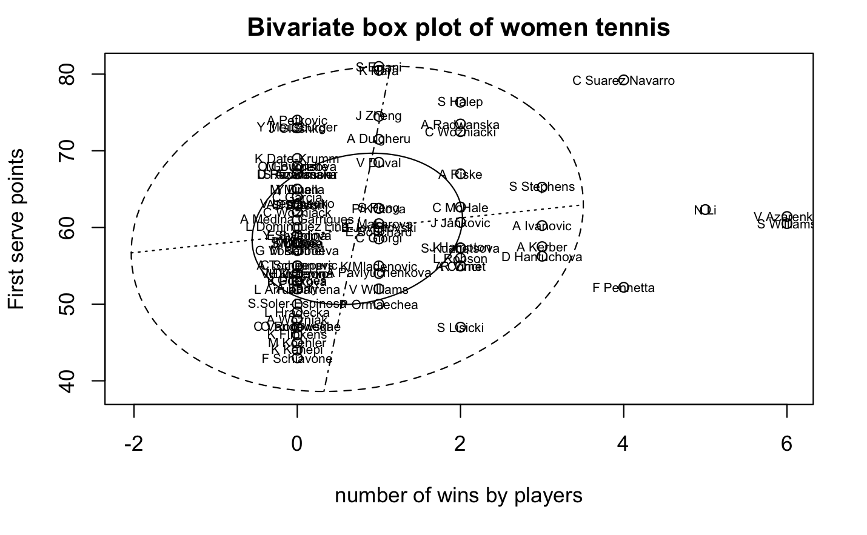
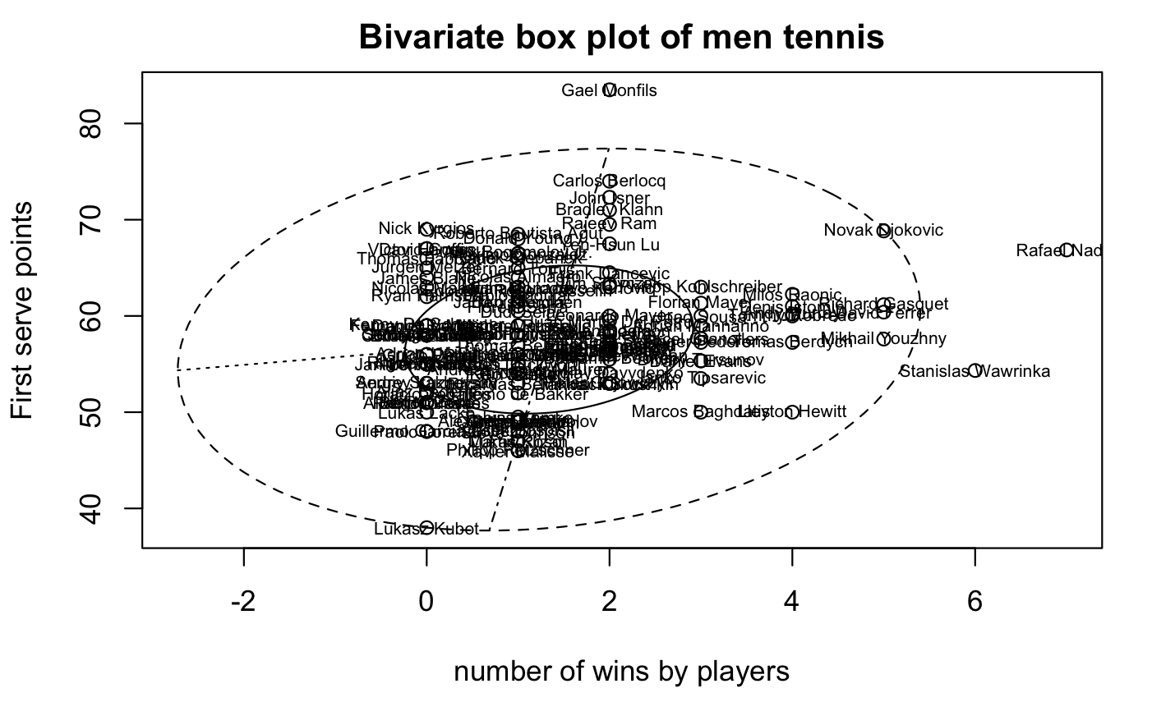

Slide 11
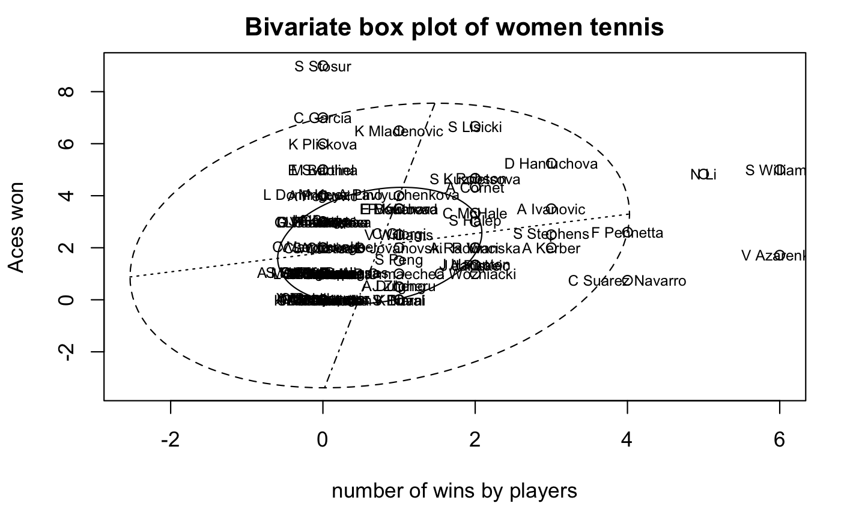
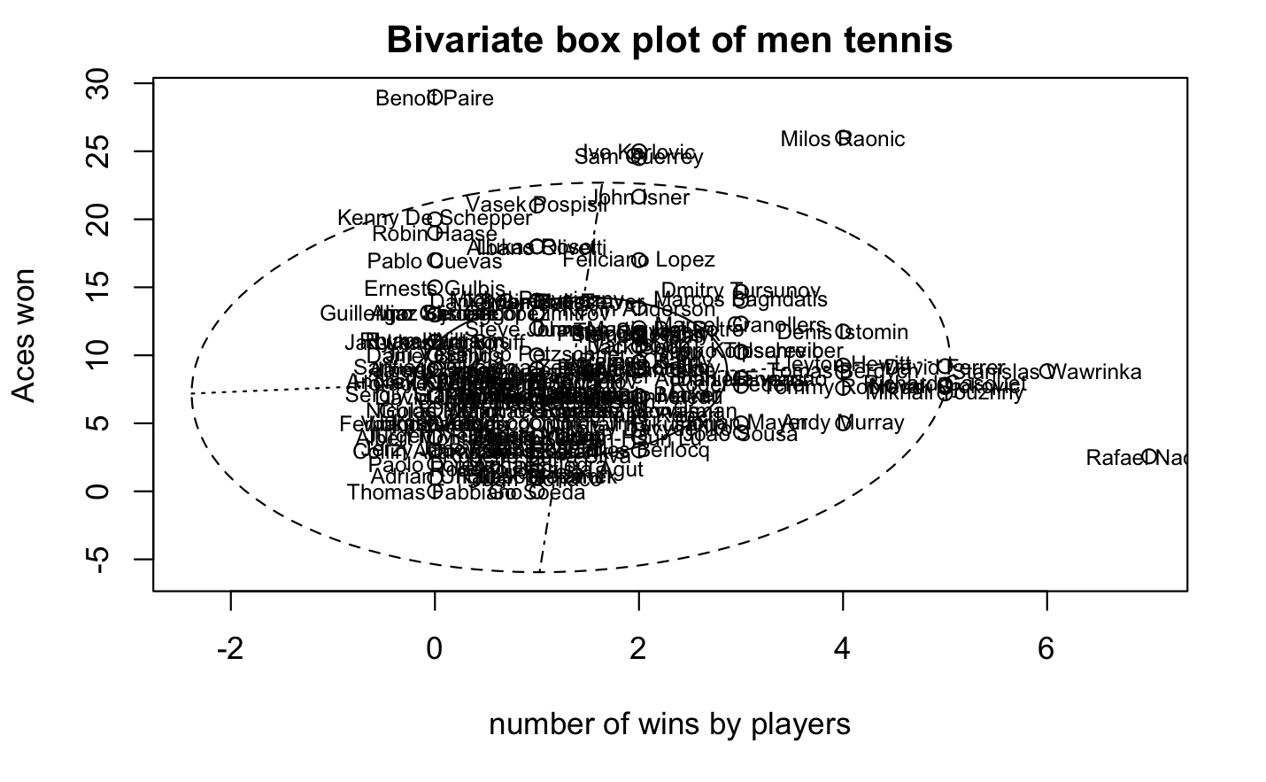

Slide 12
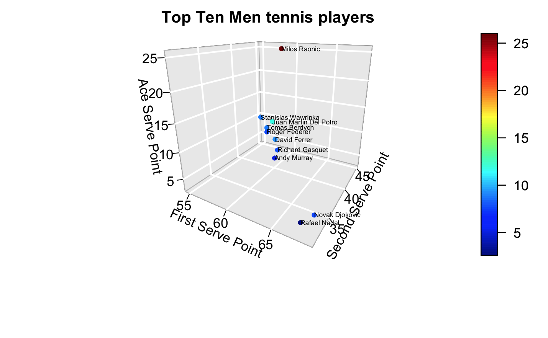

Slide 13
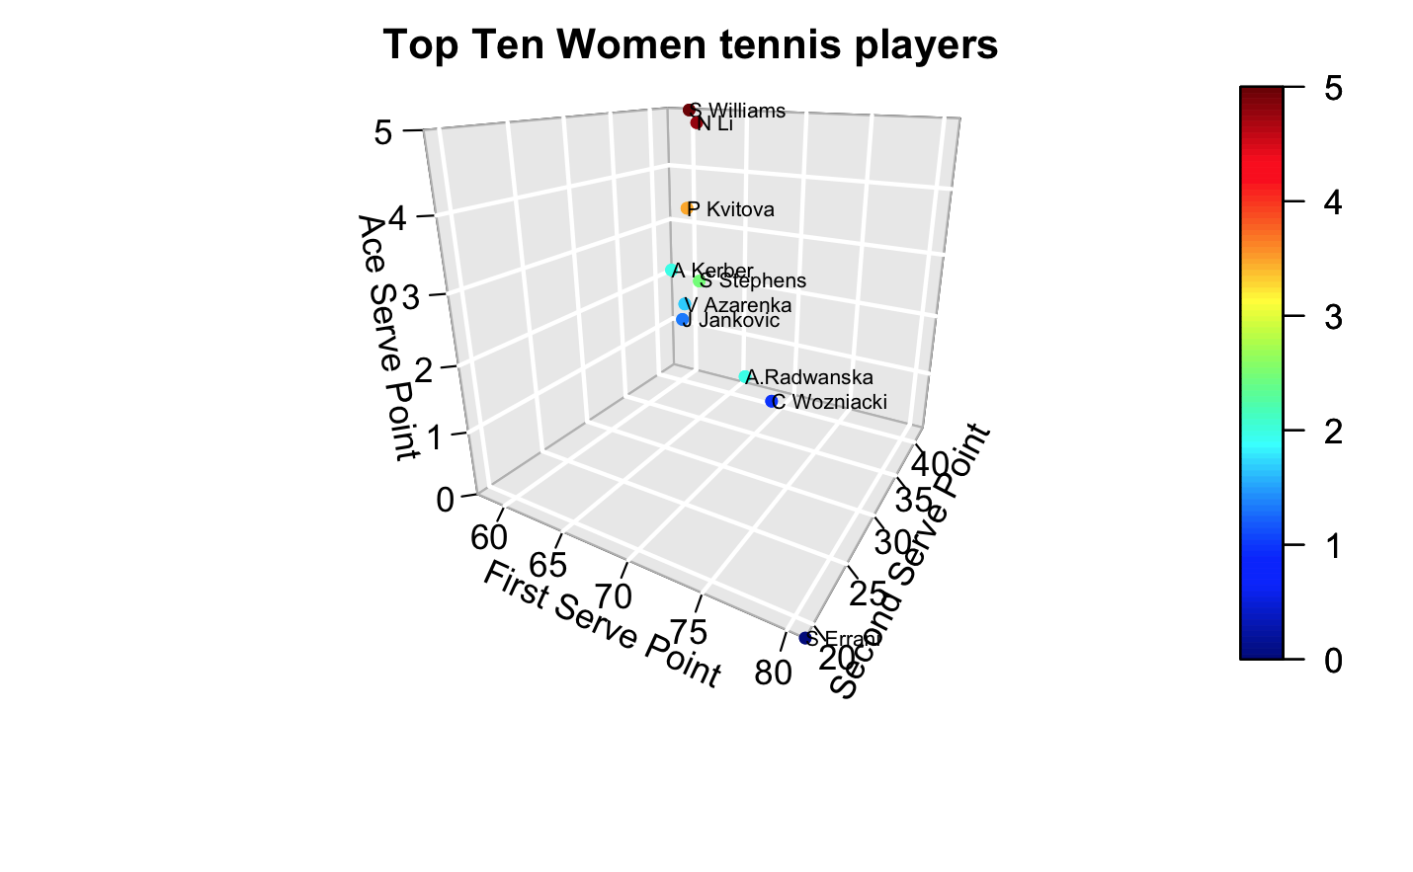

Slide 14
Insights

Slide 15
Dimension Reduction – PCA & MDS
First 3 principal components explain 75 percent of the total variance of the data
MDS shows that the players who reached finals have similar performance

Slide 16
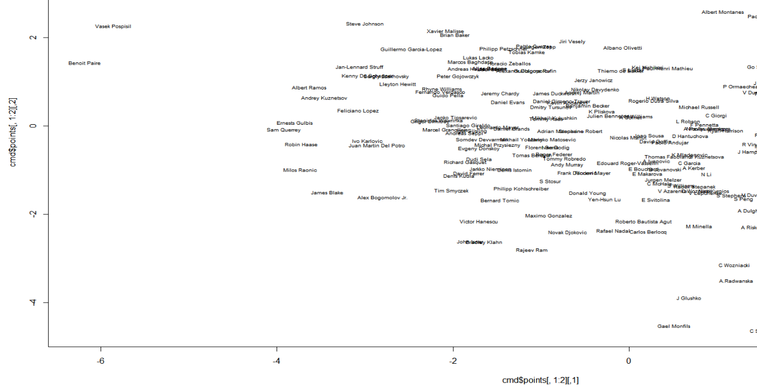

Slide 17
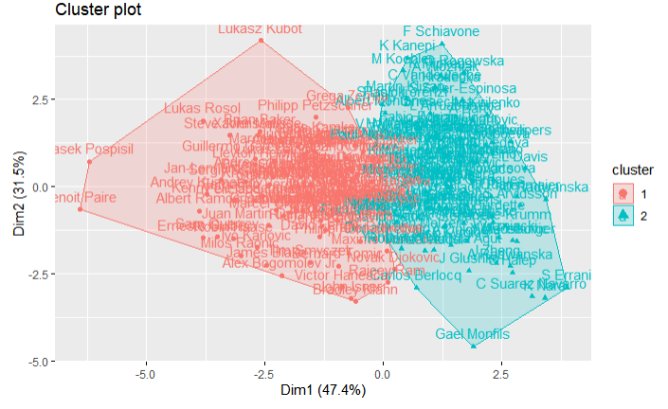

Clustering - KMeans
Two clusters

Slide 18
Determining Latent Variables - EFA
Two Latent Variables
RMSE < 0.05 & P-value > 0.05
First Serve characteristics and Second Serve characteristics

Slide 19
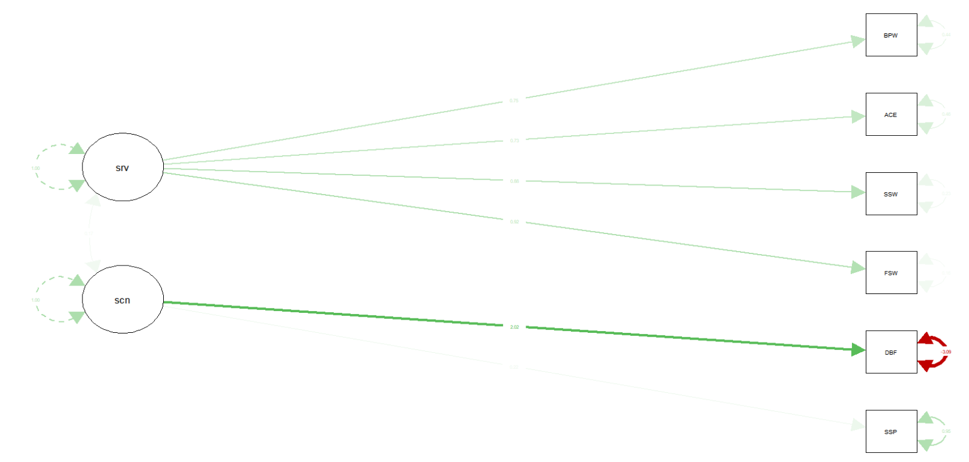
Confirmatory Factor Analysis
Not a good fit
SRMR 0.087>0.05
GFI 0.822 < 0.95
AGFI 0.533 < 0.95

Slide 20
Conclusions
Pros
Cons
Post Analysis
Successful clustering
CFA doesnot support the theory of latent variables
Data was not initially aggregated
Missing values
Use in future analysis
Compare current players performance
Find same profile in players

Slide 21

Questions

